Slide 1
NGO Committee on Sustainable Development-NY
Building Inclusive Partnerships with UN Initiatives for 2023 & Beyond
Keynote Reflections
Thursday, 22 December 2022
Amir Dossal
President & CEO, Global Partnerships Forum
Distinguished Fellow, Health and Healthcare, World Economic Forum

Slide 2
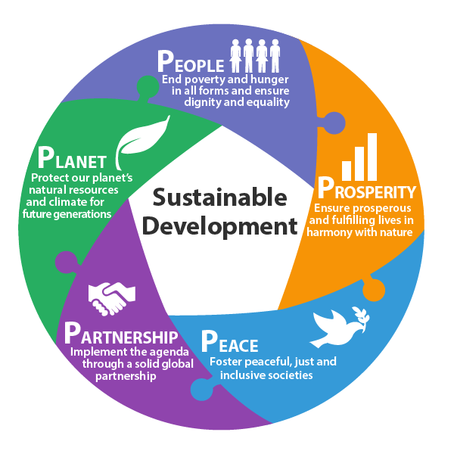
Five Pillars of the SDGs
“Creating
PEACE and PROSPERITY for
PEOPLE and the PLANET
through
PARTNERSHIPS”
No country, no organisation, and no single entity
can achieve the SDGs without working together

Slide 3
The SDGs: Where do we stand?
The SDGs were already off track, even before COVID-19
While progress had been made in some regions around poverty reduction, maternal and child health, access to electricity, and gender equality, a lot more needs to be done to achieve the Goals by 2030.
The world is in danger of missing the targets of many of the SDGs, but focused funding and innovative partnerships can get things back on track.
Investment is sorely needed, especially in Least Development Countries, which are disproportionately impacted.
According to the latest forecasts, the world needs to invest $5-7 trillion per year in sustainable projects to meet the goals – much higher than the original estimate of $3 trillion

Slide 4
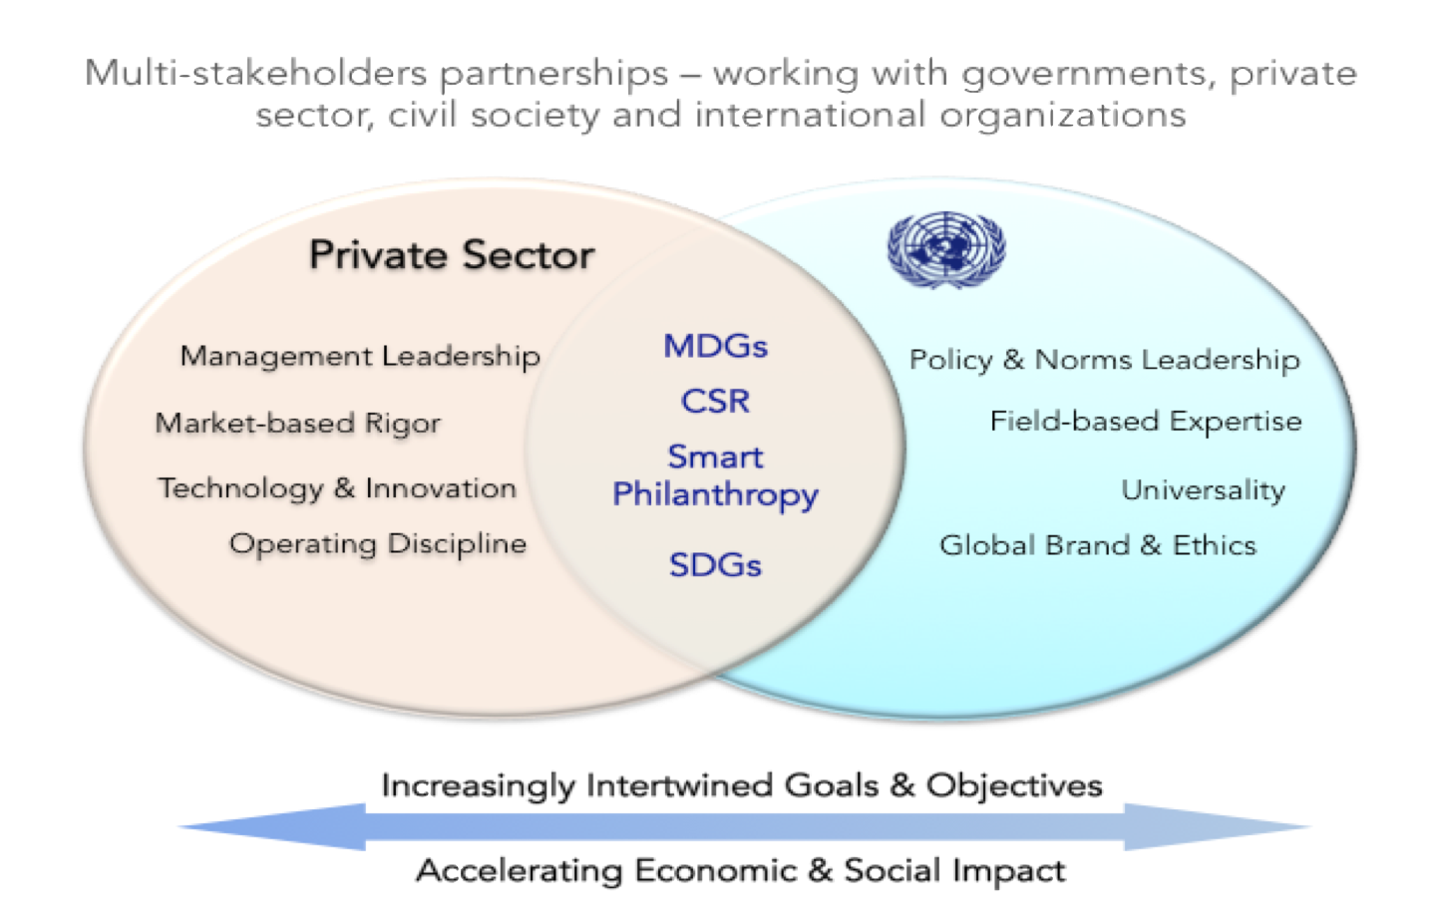
SDG 17: The Golden Thread

Slide 5
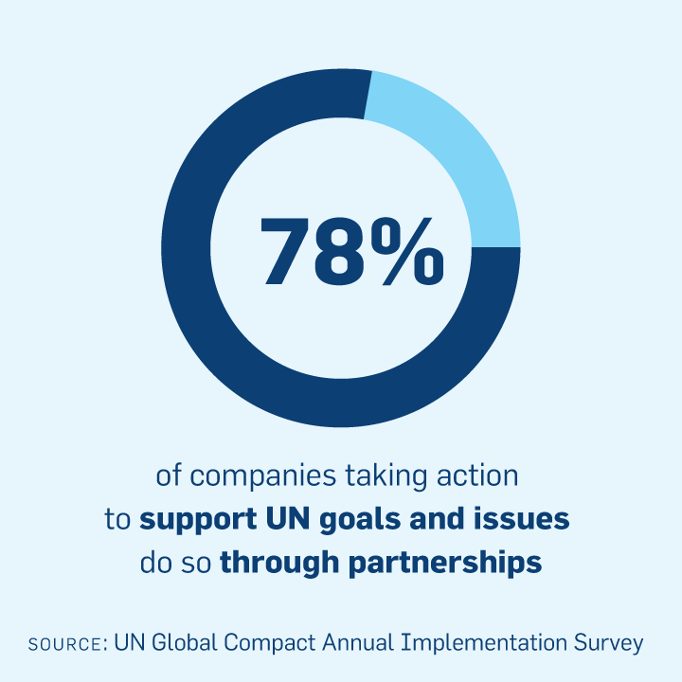
Partnerships in the UN System
The UN system has been partnering with the private sector and civil society for over 60 years
In past decade, partnerships have increased in:
Number
Significance
Scope
New forms of Partnerships: Strategic Partnerships and Smart Partnerships

Slide 6
Partnerships as a Foreign Policy Tool
Investment vs Aid
Encouraging local entrepreneurship
Innovation and Incubation
Using advertising dollars for strategic initiatives
Creating goodwill
Notes:
Aid creates dependency while investment makes you independent
Encouraging entrepreneurship at the local level
Incubation of facilities
Using advertising dollars for strategic initiatives
Achieving international objectives beyond current capabilities
Creative and innovative partnerships

Slide 7
Gender Equality
Gender equality is fundamental to delivering on the promises of sustainability, peace, and human progress
Progress in poverty reduction has reversed with women and girls paying a large price
Devastated health systems have left poorer women without care and in worse physical and mental health
Water stress is intensifying, taking tolls on women’s and girls’ time, health and lives
UN Women Gender Snapshot 2022

Slide 8
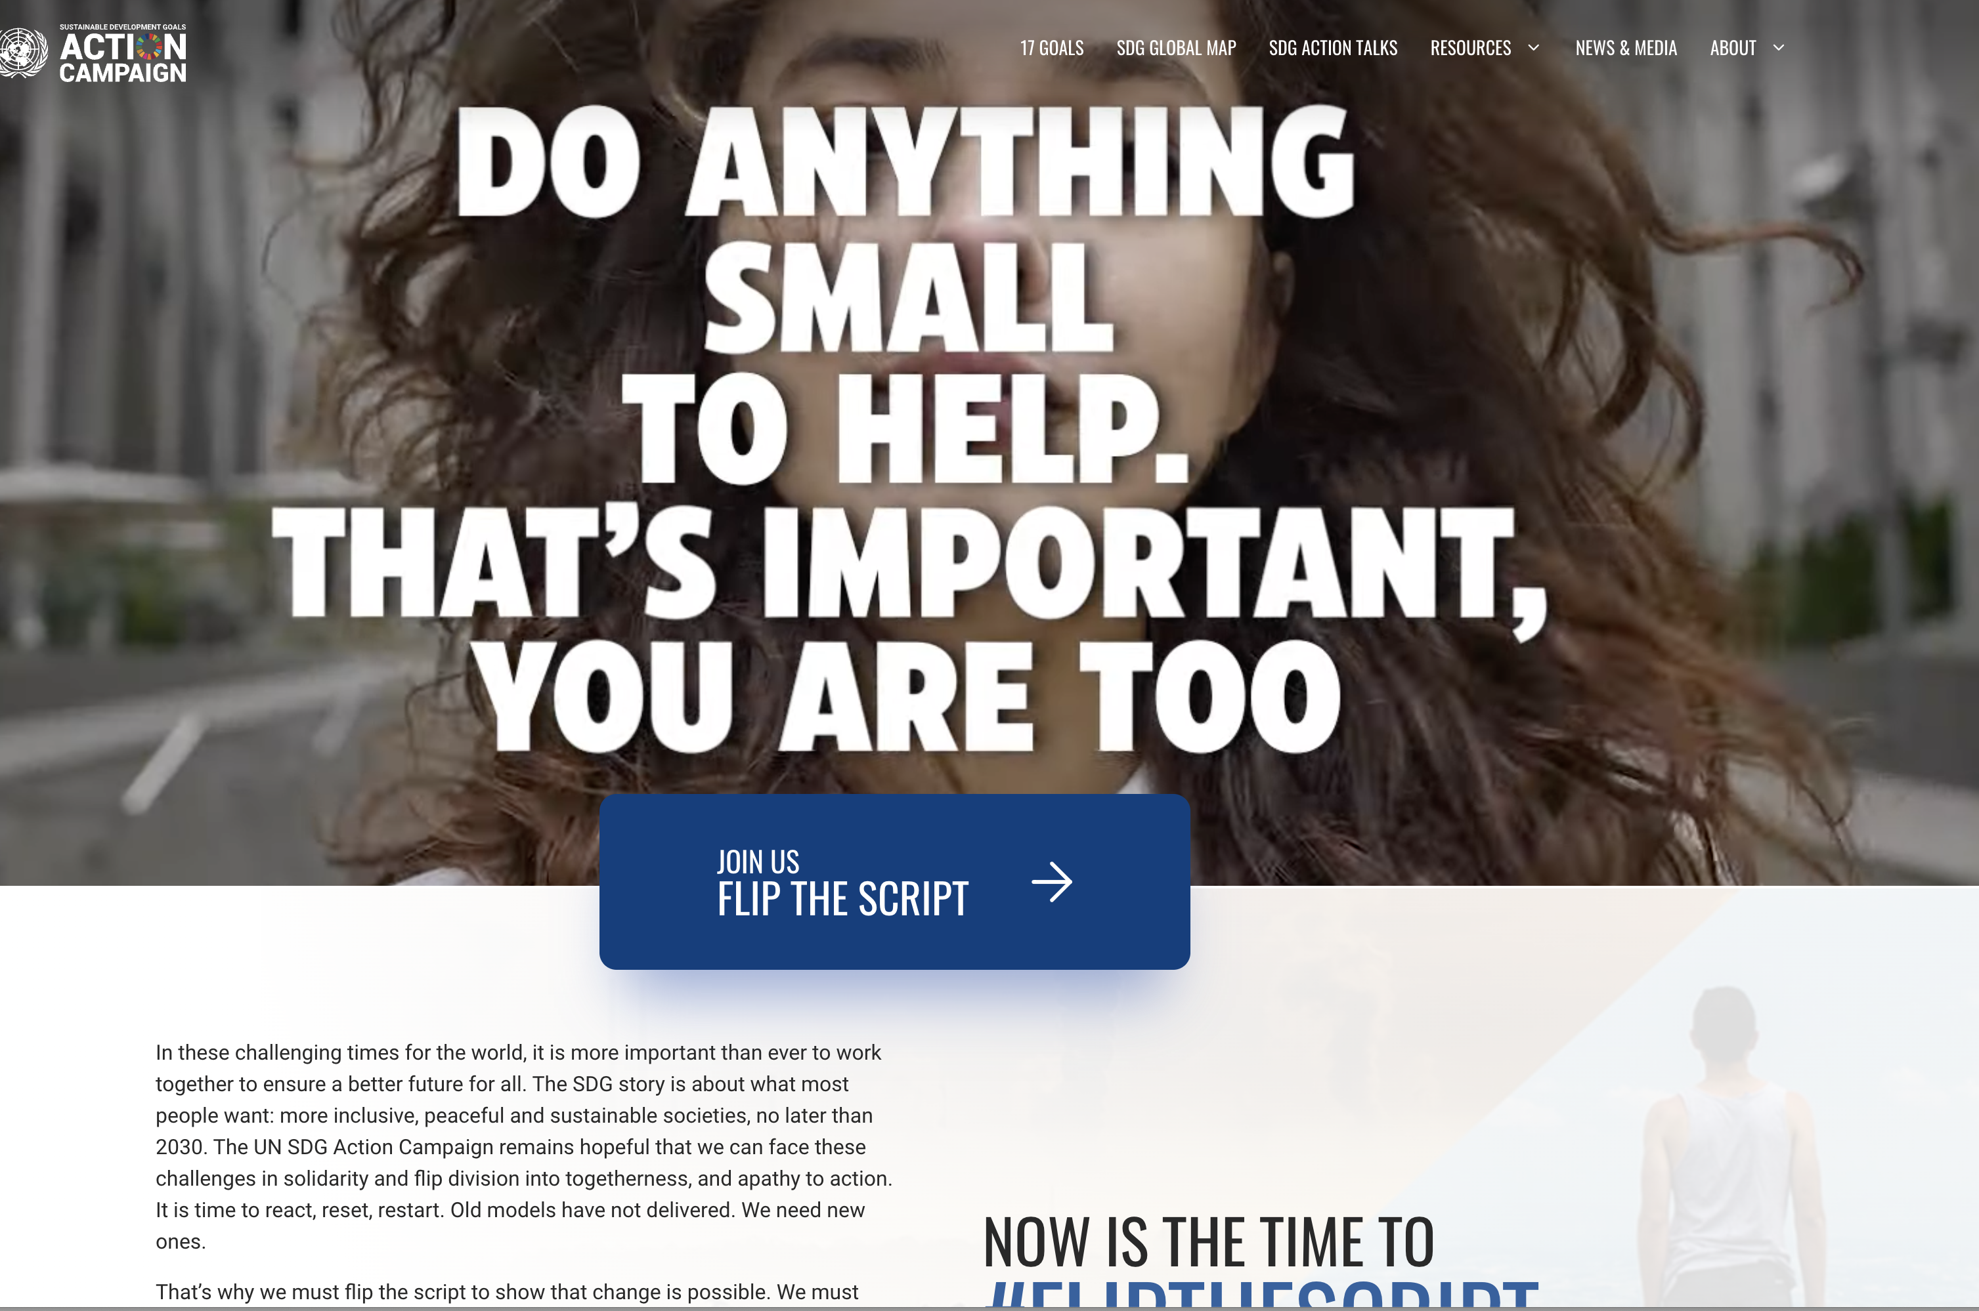
What Can You Do?
https://www.sdgactioncampaign.org

Slide 9
Youth Leadership
https://www.un.org/youthenvoy/workplan
Notes:
Partnerships are not just about NGOs and the UN, businesses benefit as well
Increasingly, more private-sector businesses have expressed interest in partnering with the UN to achieve the Sustainable Development goals
Sharing their expertise to aid the UN in moving toward a more sustainable future

Slide 10
Contribute expertise and resources
Share best practice and insights
Engage in public policy dialogue
Vet successful partnership outcomes
Serve as an advocate
Assist with media and communications
Help design innovative programs
Fund projects

Slide 11
LDC5 Conference
Notes:
Partnerships are not just about NGOs and the UN, businesses benefit as well
Increasingly, more private-sector businesses have expressed interest in partnering with the UN to achieve the Sustainable Development goals
Sharing their expertise to aid the UN in moving toward a more sustainable future

Slide 12
Global Partnerships Forum
Knowledge platform to help build innovative partnerships in support of the
2030 Agenda for Sustainable Development
Our Mission is to Foster Economic Growth by:
Engaging thought leaders, policymakers, entrepreneurs, philanthropists, and investors
Designing innovative partnerships and alliances around the SDGs
Building a knowledge base to empower social entrepreneurs
https://partnerships.org/
https://www.facebook.com/PartnershipsOrg/
https://www.linkedin.com/company/global-partnerships-forum

Slide 13
Ms. Margo LaZaro President & Chair of the NGO Committee on Sustainable Development-NY & the Dedicated Team
THANK YOU

